Slide 1
Mini Popper | Colt poppers | Pepper poppers | Plates | Wall feet
7 | 7 | 0 | 0 | 43
Bay | Stage | Target Type | Count | NS | Total | Hard Cover
1 | 22-05 | IPSC | 4 |  | 4
2 | Muddled | USPSA | 8 | 2 | 10 | 1 Left Diag 1 Right Diag
3 | Where It Goes No One Knows | USPSA | 8 | 1 | 9 | 2 Tux
4 | Home on the Range | IPSC | 12 | 1 | 13 | 1 Tux 1 Left Diag 1 Right Diag
5 | 18-08 | USPSA | 4 | 2 | 6 | 2 Left Diag 2 Right Diag
6 | Burner | USPSA | 8 | 2 | 10

Slide 2
Prop | Stage
Swinger | 4 (shoot house)
Stomp pad | 4 (shoot house)
Swinger | 2
Max trap | 2

Slide 3


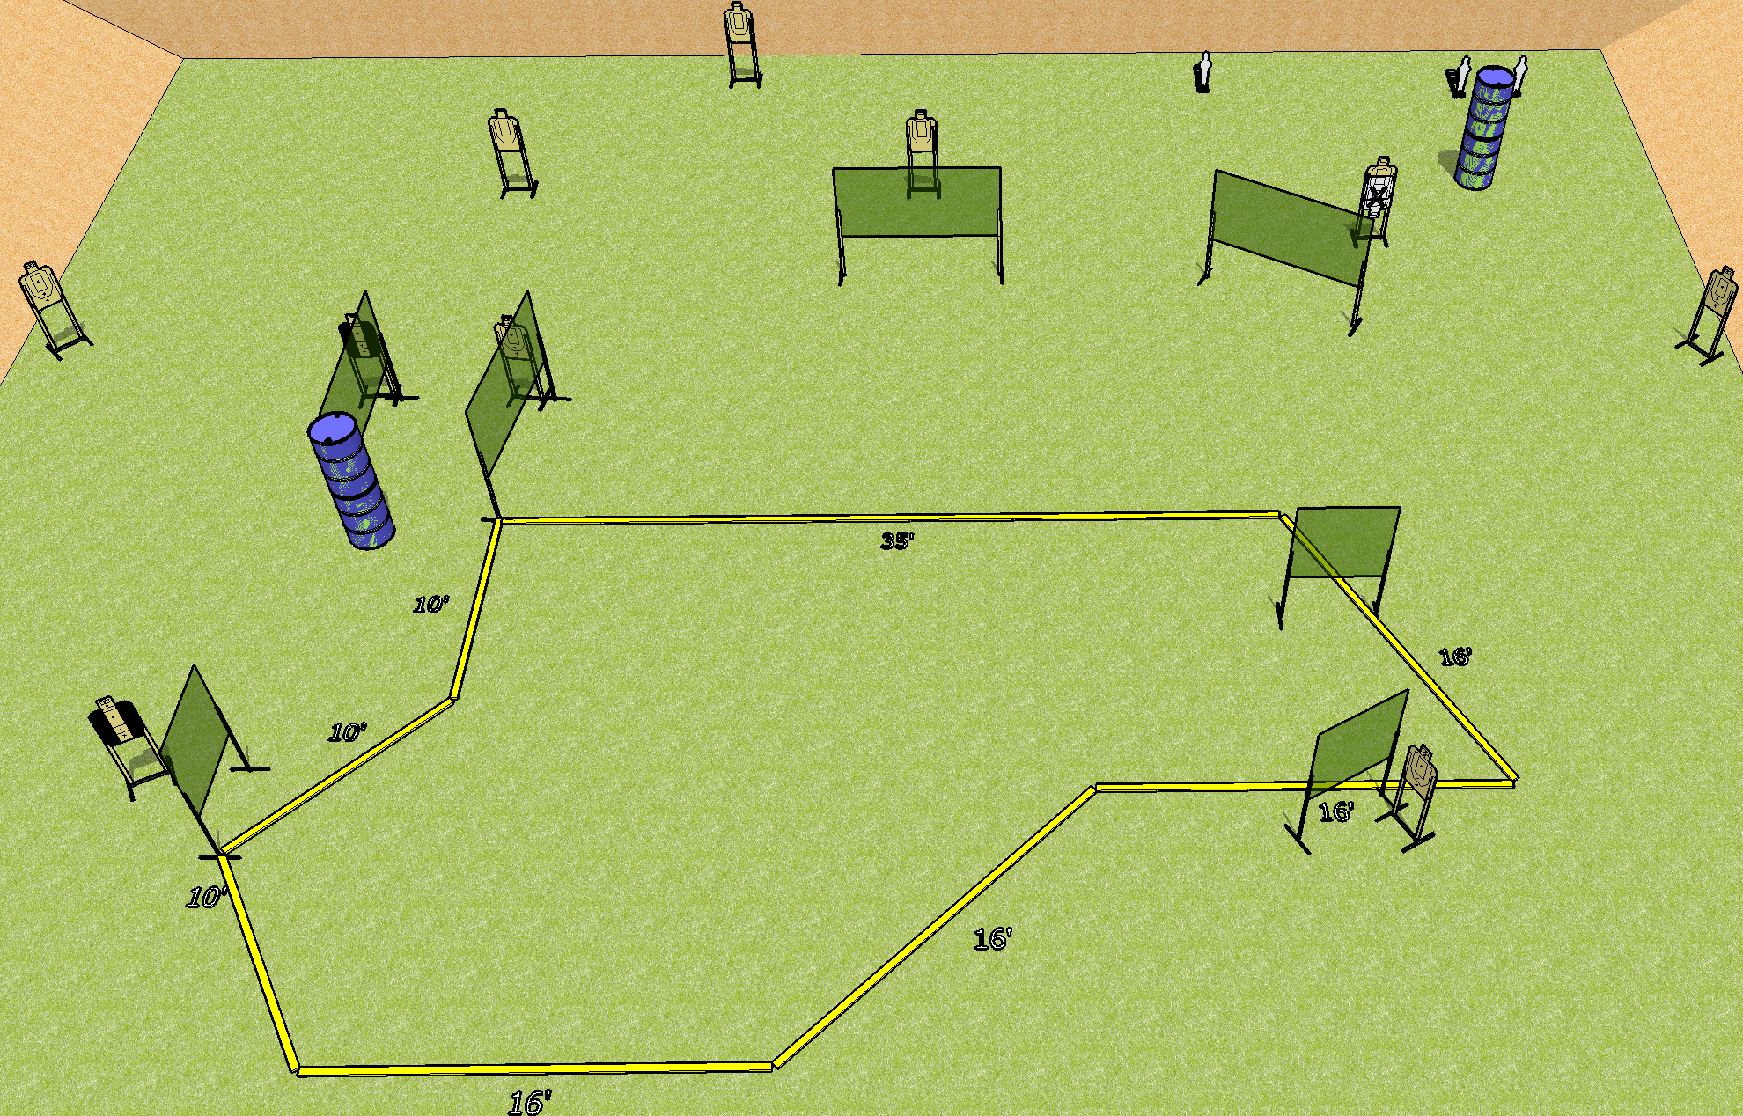
 | Dothan Gun Club – USPSA Match Where It Goes No One Knows Course Designer : Drew Coleman Bay: 3
Round Count 23 rounds 10 USPSA 3 mini poppers
Equipment List 14 wall feet 2 tux 9 targets (8 + 1 NS)

Slide 4
Where It Goes No One Knows
Written Stage Briefing
Scoring: Comstock Rounds: 23
Targets: 10 USPSA, 3 steel
Handgun start position: anywhere inside the shooting area, wrists below belt. Handgun is loaded and holstered.
PCC start position: anywhere inside the shooting area, stock on belt. Loaded carbine is held with both hands, safety on.
Stage Procedure: on the audible start signal, engage targets as they become available from within the shooting area.

Slide 5
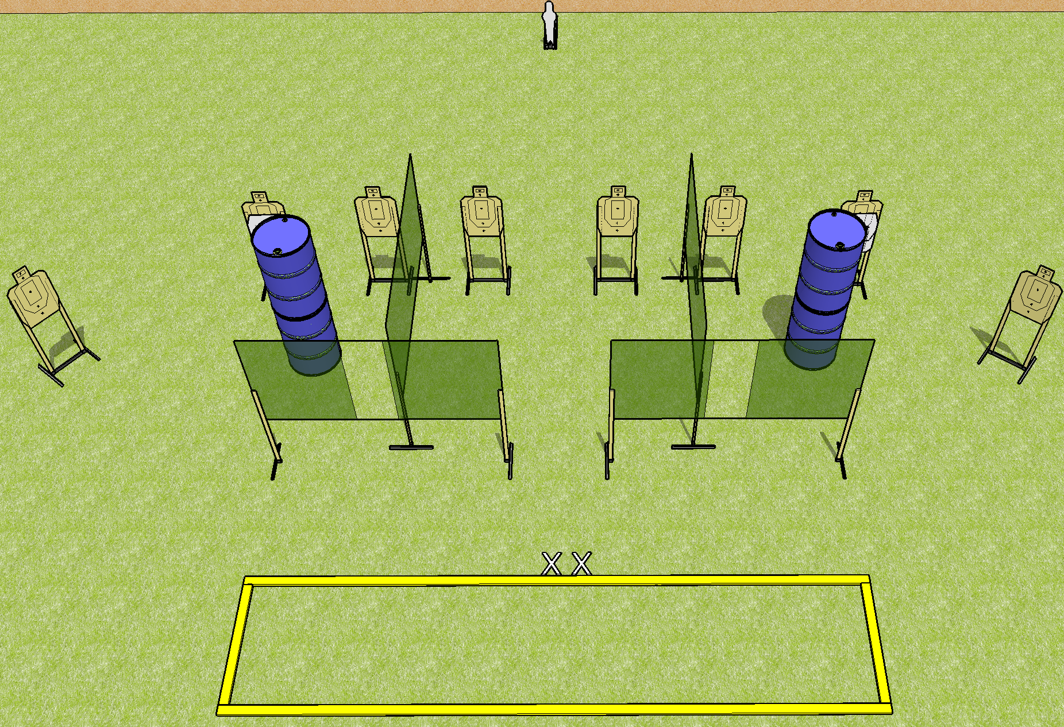
 | Dothan Gun Club – USPSA Match Burner Course Designer : Drew Coleman Bay: 6
Round Count 25 rounds 8 USPSA 1 mini popper
Equipment List 8 wall feet 10 targets (8 + 2 NS)

Slide 6
Burner
Written Stage Briefing
Scoring: Comstock Rounds: 25
Targets: 8 USPSA, 1 steel
Best 3 per target
Handgun start position: completely outside the shooting area, heels on X’s, wrists below belt. Handgun is loaded and holstered.
PCC start position: completely outside the shooting area, heels on X’s, stock on belt. Loaded carbine is held with both hands, safety on.
Stage Procedure: on the audible start signal, engage targets as they become available from within the shooting area.

Slide 7
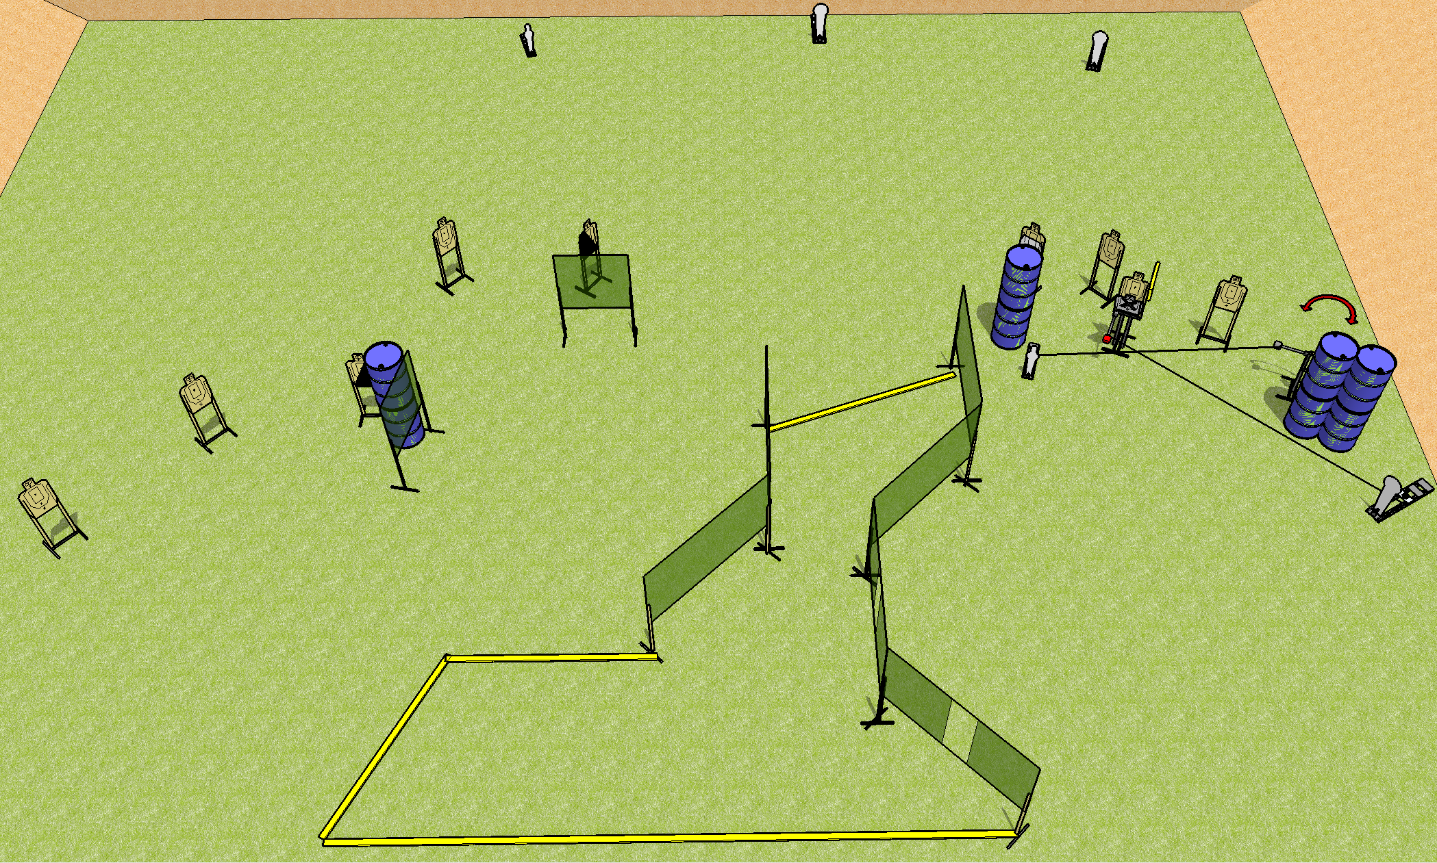
 | Dothan Gun Club – USPSA Match Muddled Course Designer : Drew Coleman Bay: 2
Round Count 25 rounds 10 USPSA 3 colt poppers, 2 minis
Equipment List 16 wall feet Swinger + max trap + activators 1 left + right diag 10 targets (8 + 2NS) 30 feet from upper right colt popper to shooting area. 26 feet from activator steel to ports.

Slide 8
Muddled
Written Stage Briefing
Scoring: Comstock Rounds: 25
Targets: 10 USPSA, 5 steel
Handgun start position: anywhere inside the shooting area, wrists below belt. Handgun is loaded and holstered.
PCC start position: anywhere inside the shooting area, stock on belt. Loaded carbine is held with both hands, safety on.
Stage Procedure: on the audible start signal, engage targets as they become available from within the shooting area.
The max trap is activated by P5 and remains visible at rest. The swinger is activated by P4 and remains visible at rest.

Slide 9
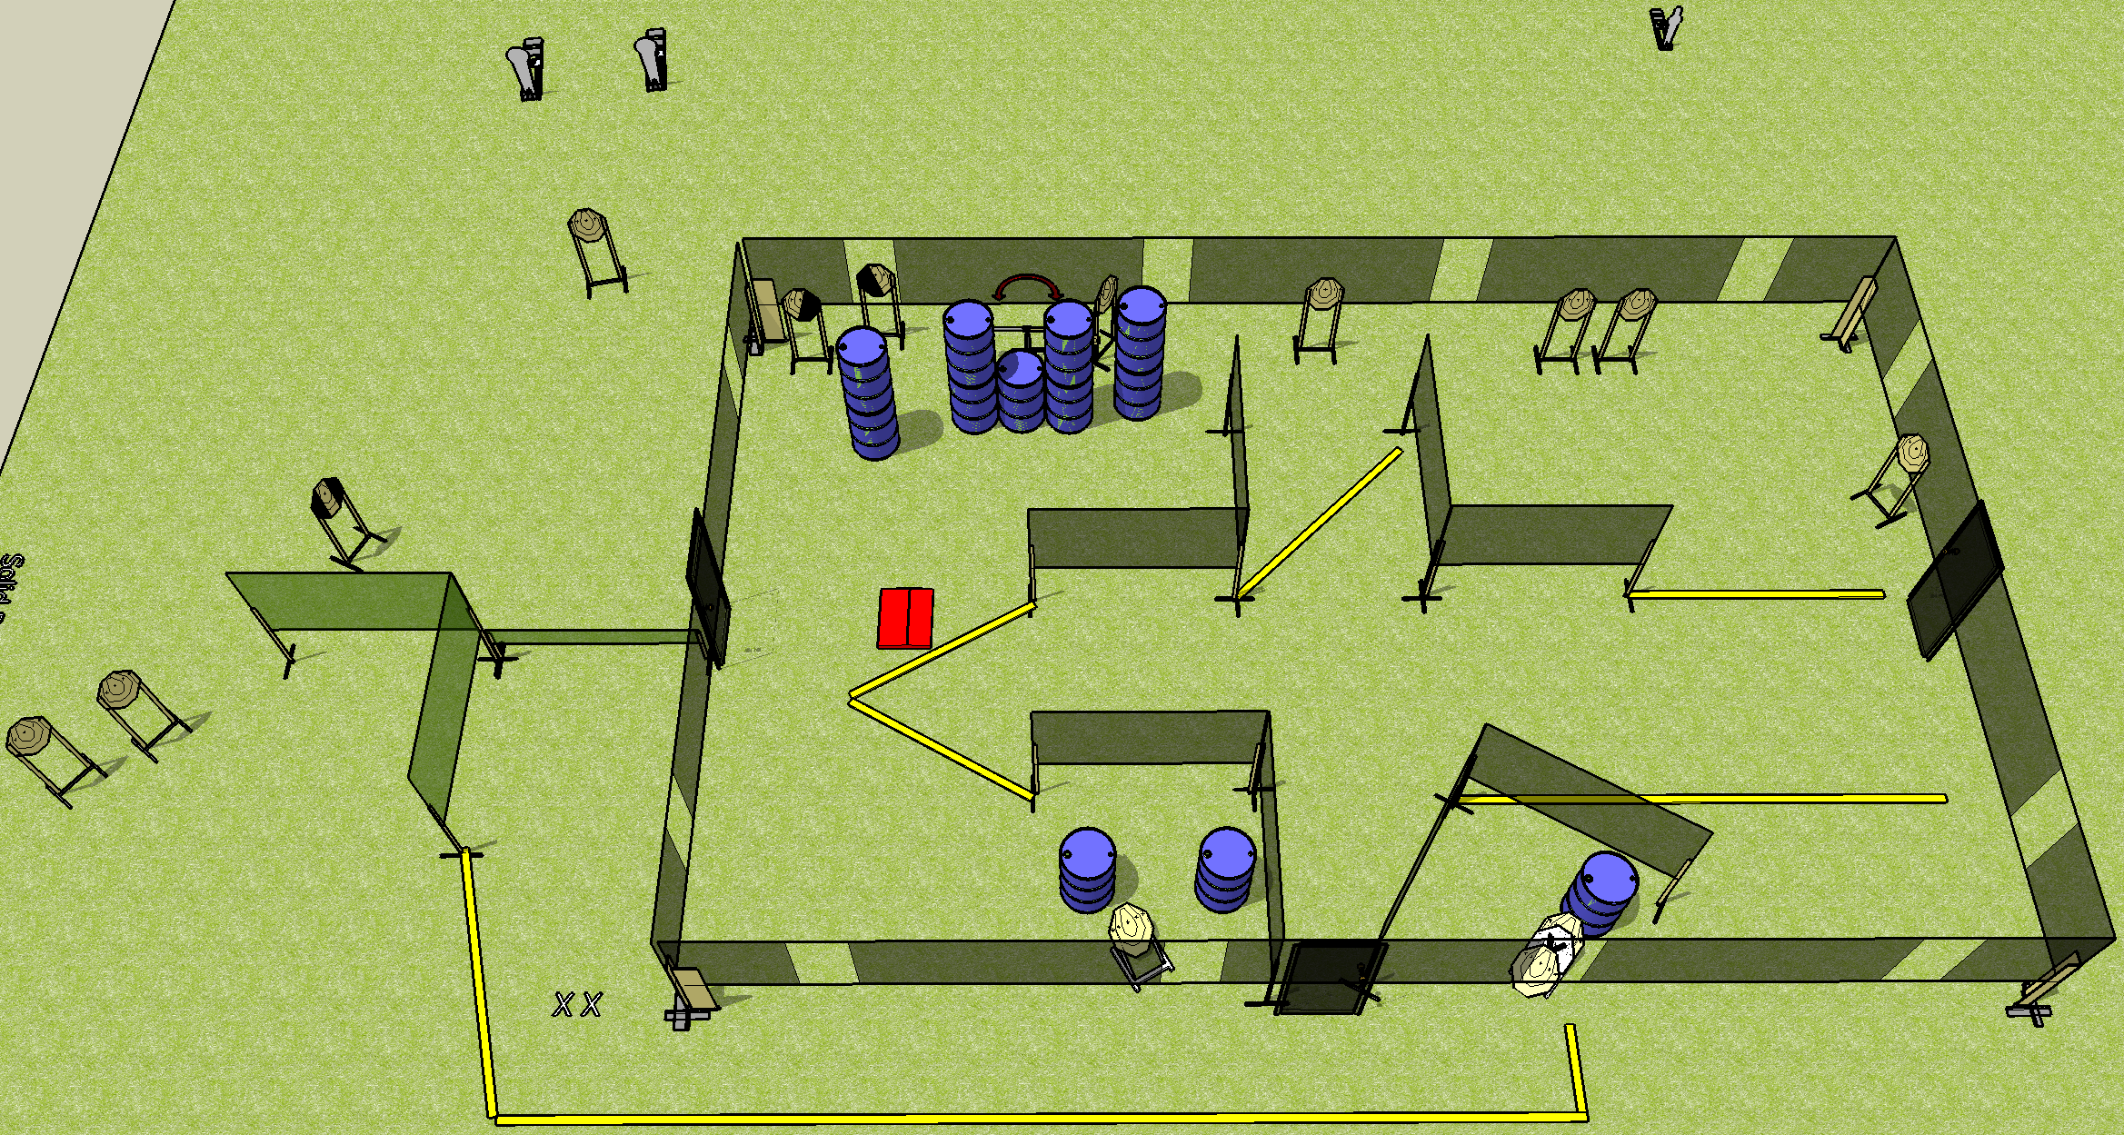
 | Dothan Gun Club – USPSA Match Home on the Range Course Designer : Drew Coleman Bay: 4
Round Count 33 rounds 15 IPSC 2 colt poppers, 1 mini
Equipment List 5 wall feet Swinger + stomp pad Low wall 1 tux, 1 left + 1 right diag 13 targets (12 + 1 NS)

Slide 10
Home on the Range
Written Stage Briefing
Scoring: Comstock Rounds: 33 rounds
Targets: 15 IPSC, 3 Steel
Handgun start position: feet on X’s, wrists below belt. Handgun is loaded and holstered.
PCC start position: feet on X’s, stock on belt. Loaded carbine is held with both hands, safety on.
Stage Procedure: on the audible start signal, engage targets as they become available from within the shooting area.

